Slide 1
Welcome to !
Theory Of Automata

Slide 2
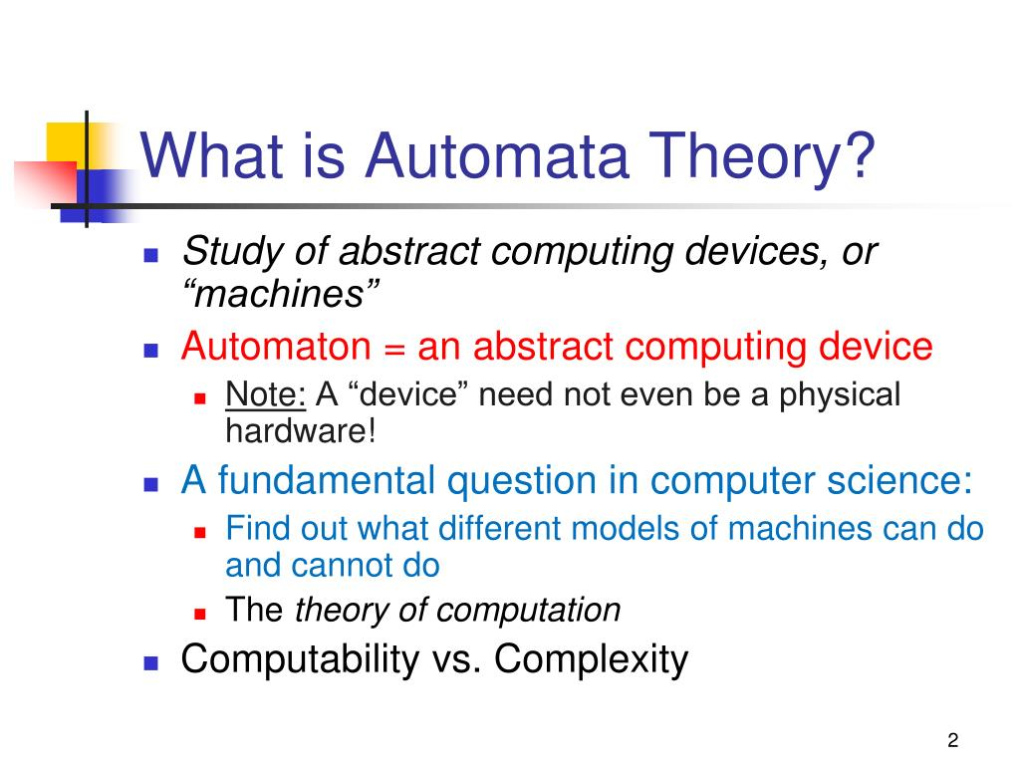

Slide 3
Introduction to languages
There are two types of languages
  Formal Languages (Syntactic languages)
  Informal Languages (Semantic languages)

Slide 4
Alphabets
Definition:
A finite non-empty set of symbols (letters), is called an alphabet. It is denoted by Σ ( Greek letter sigma).
Example:
Σ={a,b}
Σ={0,1} //important as this is the language //which the computer understands.
Σ={i,j,k}

Slide 5
Strings
Definition:
Concatenation of finite symbols from the alphabet is called a string.
Example:
If Σ= {a,b} then
a, abab, aaabb, ababababababababab

Slide 6
NOTE:
EMPTY STRING or NULL STRING
Sometimes a string with no symbol at all is used, denoted by (Small Greek letter Lambda) λ or (Capital Greek letter Lambda) Λ(upper case Lambda), ε (Epsilon) is called an empty string or null string.
The capital lambda will mostly be used to denote the empty string, in further discussion.

Slide 7
Words
Definition:
Words are strings belonging to some language.
Example:
If Σ= {x} then a language L can be defined as
L={x^{n} : n=1,2,3,…..} or L={x,xx,xxx,….}
L={x^{n} : n=0, 1,2,3,…..} or L={lamda,x,xx,xxx,….}
Here x,xx,… are the words of L

Slide 8
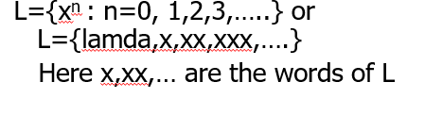
NOTE:
All words are strings, but not all strings are words.
ab is string but not word of this language

Slide 9
Valid/In-valid alphabets
While defining an alphabet, an alphabet may contain letters consisting of group of symbols for example Σ₁= {B, aB, bab, d}.
Now consider an alphabet
Σ₂= {B, Ba, bab, d} and a string BababB.

Slide 10
BababB.
Σ₂= {B, Ba, bab, d}
This string can be tokenized in two different ways
  (Ba), (bab), (B)
  (B), (abab), (B)
Which shows that the second group cannot be identified as a string, defined over
Σ = {a, b}.

Slide 11
As when this string is scanned by the compiler (Lexical Analyzer), first symbol B is identified as a letter belonging to Σ, while for the second letter the lexical analyzer would not be able to identify, so while defining an alphabet it should be kept in mind that ambiguity should not be created.

Slide 12
Remarks:
While defining an alphabet of letters consisting of more than one symbols, no letter should be started with the letter of the same alphabet i.e. one letter should not be the prefix of another. However, a letter may be ended in the letter of same alphabet i.e. one letter may be the suffix of another.

Slide 13
Conclusion
Σ₁= {B, aB, bab, d}
Σ₂= {B, Ba, bab, d}
Σ₁ is a valid alphabet while Σ₂ is an in-valid alphabet.

Slide 14
Length of Strings
Definition:
The length of string s, denoted by |s|, is the number of letters in the string.
Example:
Σ={a,b}
s=ababa
|s|=5

Slide 15
Example:
Σ= {B, aB, bab, d}
s=BaBbabBd
Tokenizing=(B), (aB), (bab), (B),(d)
|s|=5

Slide 16
Reverse of a String
Definition:
The reverse of a string s denoted by Rev(s) or s^{r}, is obtained by writing the letters of s in reverse order.
Example:
If s=abc is a string defined over Σ={a,b,c}
then Rev(s) or s^{r} = cba

Slide 17
Example:
Σ= {B, aB, bab, d}
s=BaBbabBd
Rev(s)=d,B,bab,aB,B

Slide 18




Another Operation
Example:
Definition:
Courtesy Costas Busch - RPI

Slide 19



The * Operation
: the set of all possible strings from
alphabet
Courtesy Costas Busch - RPI

Slide 20


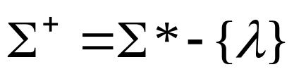
The + Operation
: the set of all possible strings from
alphabet except
Courtesy Costas Busch - RPI

Slide 21


Languages
A language is any subset of
Example:
Languages:
Courtesy Costas Busch - RPI

Slide 22




Note that:
Sets
Set size
Set size
String length
Courtesy Costas Busch - RPI

Slide 23




Another Example
An infinite language
Courtesy Costas Busch - RPI

Slide 24



Reverse
Definition:
Examples:
Courtesy Costas Busch - RPI

Slide 25


Concatenation
Definition:
Example:
Courtesy Costas Busch - RPI

Slide 26



Another Operation
Definition:
Special case:
Courtesy Costas Busch - RPI

Slide 27



More Examples
Courtesy Costas Busch - RPI

Slide 28


Star-Closure (Kleene *)
Definition:
Example:
Courtesy Costas Busch - RPI

Slide 29
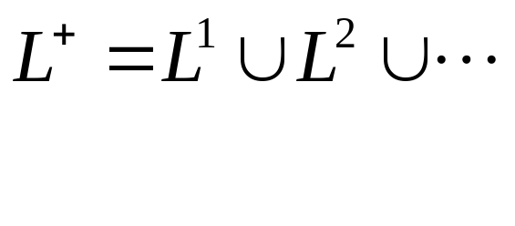

Positive Closure
Definition:
Courtesy Costas Busch - RPI

Slide 30
Defining Languages
The languages can be defined in different ways , such as Descriptive definition, using Regular Expressions(RE) and using Finite Automaton(FA) etc.
Descriptive definition of language:
The language is defined, describing the conditions imposed on its words.

Slide 31
Example:
The language L of strings of odd length, defined over Σ={a}, can be written as
L={a, aaa, aaaaa,…..}
Example:
The language L of strings that does not start with a, defined over Σ={a,b,c}, can be written as
L={b, c, ba, bb, bc, ca, cb, cc, …}

Slide 32
Example:
The language L of strings of length 2, defined over Σ={0,1,2}, can be written as
L={00, 01, 02,10, 11,12,20,21,22}
Example:
The language L of strings ending in 0, defined over Σ ={0,1}, can be written as
L={0,00,10,000,010,100,110,…}

Slide 33
Example: The language EQUAL, of strings with number of a’s equal to number of b’s, defined over Σ={a,b}, can be written as
{Λ ,ab,aabb,abab,baba,abba,…}
Example: The language EVEN-EVEN, of strings with even number of a’s and even number of b’s, defined over Σ={a,b}, can be written as
{Λ, aa, bb, aaaa,aabb,abab, abba, baab, baba, bbaa, bbbb,…}

Slide 34
Example: The language INTEGER, of strings defined over Σ={-,0,1,2,3,4,5,6,7,8,9}, can be written as
INTEGER = {…,-2,-1,0,1,2,…}
Example: The language EVEN, of stings defined over Σ={-,0,1,2,3,4,5,6,7,8,9}, can be written as
EVEN = { …,-4,-2,0,2,4,…}

Slide 35
Example: The language {a^{n}b^{n} }, of strings defined over Σ={a,b}, as
{a^{n} b^{n} : n=1,2,3,…}, can be written as
{ab, aabb, aaabbb,aaaabbbb,…}
Example: The language {a^{n}b^{n}a^{n} }, of strings defined over Σ={a,b}, as
{a^{n} b^{n} a^{n}: n=1,2,3,…}, can be written as
{aba, aabbaa, aaabbbaaa,aaaabbbbaaaa,…}

Slide 36
Example: The language factorial, of strings defined over Σ={1,2,3,4,5,6,7,8,9} i.e.
{1,2,6,24,120,…}
Example: The language FACTORIAL, of strings defined over Σ={a}, as
{a^{n!} : n=1,2,3,…}, can be written as
{a,aa,aaaaaa,…}. It is to be noted that the language FACTORIAL can be defined over any single letter alphabet.

Slide 37
Example: The language DOUBLEFACTORIAL, of strings defined over Σ={a, b}, as
{a^{n!}b^{n!} : n=1,2,3,…}, can be written as
{ab, aabb, aaaaaabbbbbb,…}
Example: The language SQUARE, of strings defined over Σ={a}, as
{a^{n 2} : n=1,2,3,…}, can be written as
{a, aaaa, aaaaaaaaa,…}

Slide 38
Example: The language DOUBLESQUARE, of strings defined over Σ={a,b}, as
{a^{n 2} b^{n 2} : n=1,2,3,…}, can be written as
{ab, aaaabbbb, aaaaaaaaabbbbbbbbb,…}

Slide 39
Example: The language PRIME, of strings defined over Σ={a}, as
{a^{p} : p is prime}, can be written as
{aa,aaa,aaaaa,aaaaaaa,aaaaaaaaaaa…}

Slide 40
An Important language
PALINDROME:
The language consisting of Λ and the strings s defined over Σ such that Rev(s)=s.
It is to be denoted that the words of PALINDROME are called palindromes.
Example:For Σ={a,b},
PALINDROME={Λ , a, b, aa, bb, aaa, aba, bab, bbb, ...}

Slide 41
Note
Number of strings of length ‘m’ defined over alphabet of ‘n’ letters is n^{m}.
Examples:
  The language of strings of length 2, defined over Σ={a,b} is L={aa, ab, ba, bb} i.e. number of strings = 2²
  The language of strings of length 3, defined over Σ={a,b} is L={aaa, aab, aba, baa, abb, bab, bba, bbb} i.e. number of strings = 2³

